Slide 1


Technology Tools for Job Search
Shireen DuPreez

Slide 2

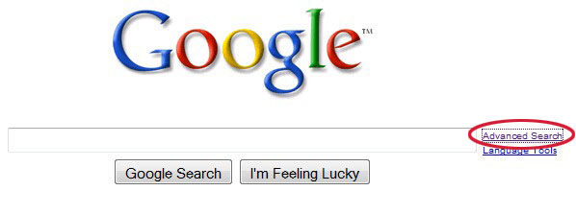
Google
  Use the Basic Search and Advanced Search functionality.
  Check your first page results, you need 10 optimized links to appear.
  Set up Google Alerts.
How to Search on Google:
https://support.google.com/websearch/answer/134479?src=soctw

Slide 3

LinkedIn
  Your LinkedIn profile is ideal for personal branding.
  Ranks highly on search results.
  Great for connecting, networking, researching and asking for leads.
  Advanced research functions to locate key contacts.
  Aim for top 10 in search results, make sure you are at least in the top 100 search results for your profession.
How to use LinkedIn: https://www.linkedin.com/help/linkedin

Slide 4

Facebook
  High trust platform.
  Great place to ask for help.
  Has search functionality.
  Can rank well if you optimise and adjust privacy settings (use caution!).
How to use Facebook:
https://www.facebook.com/help

Slide 5

Twitter
Great for succinct personal branding.
Ranks highly on search results.
Useful for connecting, networking, researching and promoting yourself.
How to use Twitter:
https://support.twitter.com/articles/215585

Slide 6


Instagram, Pinterest
  Highly visual picture sharing platforms.
  Usefulness depends on your profession.
  Show a polished version of your personal life, hobbies and interests.
  Useful for connecting, networking, researching and asking for leads.

Slide 7
Other Platforms
  YouTube – Ranks highly in search results.
  Google+ - Ranks highly in search results.
  Slideshare – Showcase your presentations. Link it with LinkedIn.
  About.me – Build your own professional landing page and add your resume.
  Quora – Answer questions relevant to your profession to show thought leadership.
  Vimeo – Simlar to YouTube
  Tumblr – Microblogging more suited to teen and college age. Showcase your hobbies.
  Look for industry specific platforms to list your professional profile.

Slide 8





Shireen DuPreez
Founder and Principal
Elite Human Capital
+61 (0) 414 767 821
www.shireendupreez.com
www.elite-human-capital.com
Connect with me!

